Slide 1
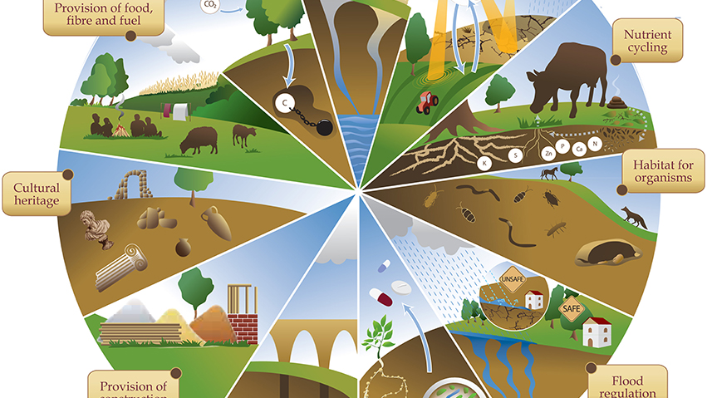
LAND RESOURCES:
Land is a naturally occurring finite resource. It provides the base for survival of living beings. It holds everything that constitutes terrestrial ecosystems. Land resources are mainly divided into two
Underground land resources and upper ground land resources.
This Photo by Unknown author is licensed under CC BY.

Slide 2
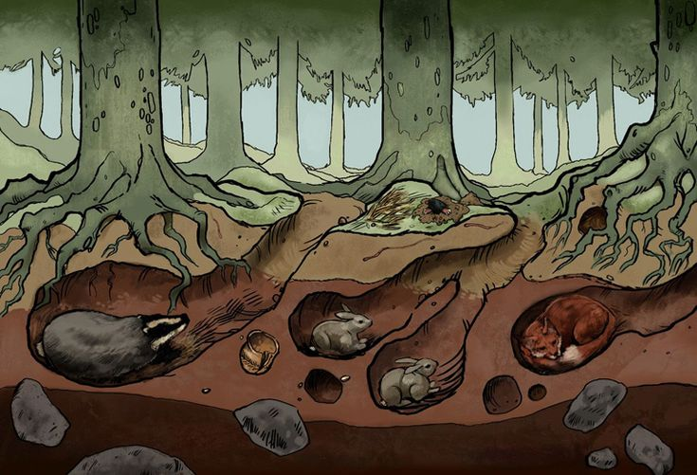

Land resources: it is a home to humans, animals and fossorial animals.

Slide 3
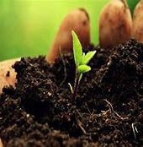
Land resources : SOIL FERTILITY

Slide 4
Importance's of soil fertility :
A fertile soil is essential for optimum productivity , protection of ground water quality and soil from erosion.
Soil is upper layer of what is usually referred to as land.
Soil is a result of the accumulation of decomposing plant and animal matter with the ageing parent material. As this soil breaks down, these elements are released in the form of nutrients that are directly available to the growing plant.
Soil fertility is the ability of soil to sustain plant growth and optimize crop yield.
A fertile soil is one that contains an adequate supply of are the nutrients required for the successful completion of plant life cycle.

Slide 5

Land resources : FOREST

Slide 6
Importance's of forest :
Forest is a natural area full of trees and wildlife.
Forest is one of the major source of oxygen on planet earth.
Forests cover one-third of Earth and breathe life into our world – literally. Over 40 percent of the world's oxygen is produced by tropical forests, while forests contribute to the critical balance of oxygen, carbon dioxide and humidity in the air.
Broadly, forest plant foods can be categorized as leaves, wood, seeds and nuts, fruits, tubers and roots, fungi, gum and sap. Collectively they add diversity and flavoring as well as providing protein, energy, vitamins and essential minerals to the human diet.
Wood is used to make beautiful Furnitures and it is also used in industries

Slide 7
Under ground land resources

Slide 8
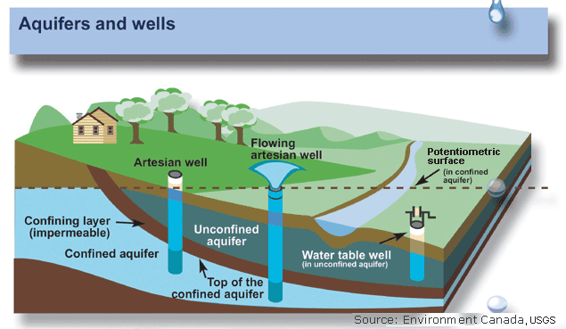
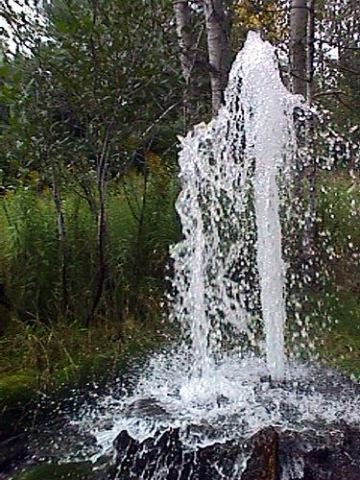
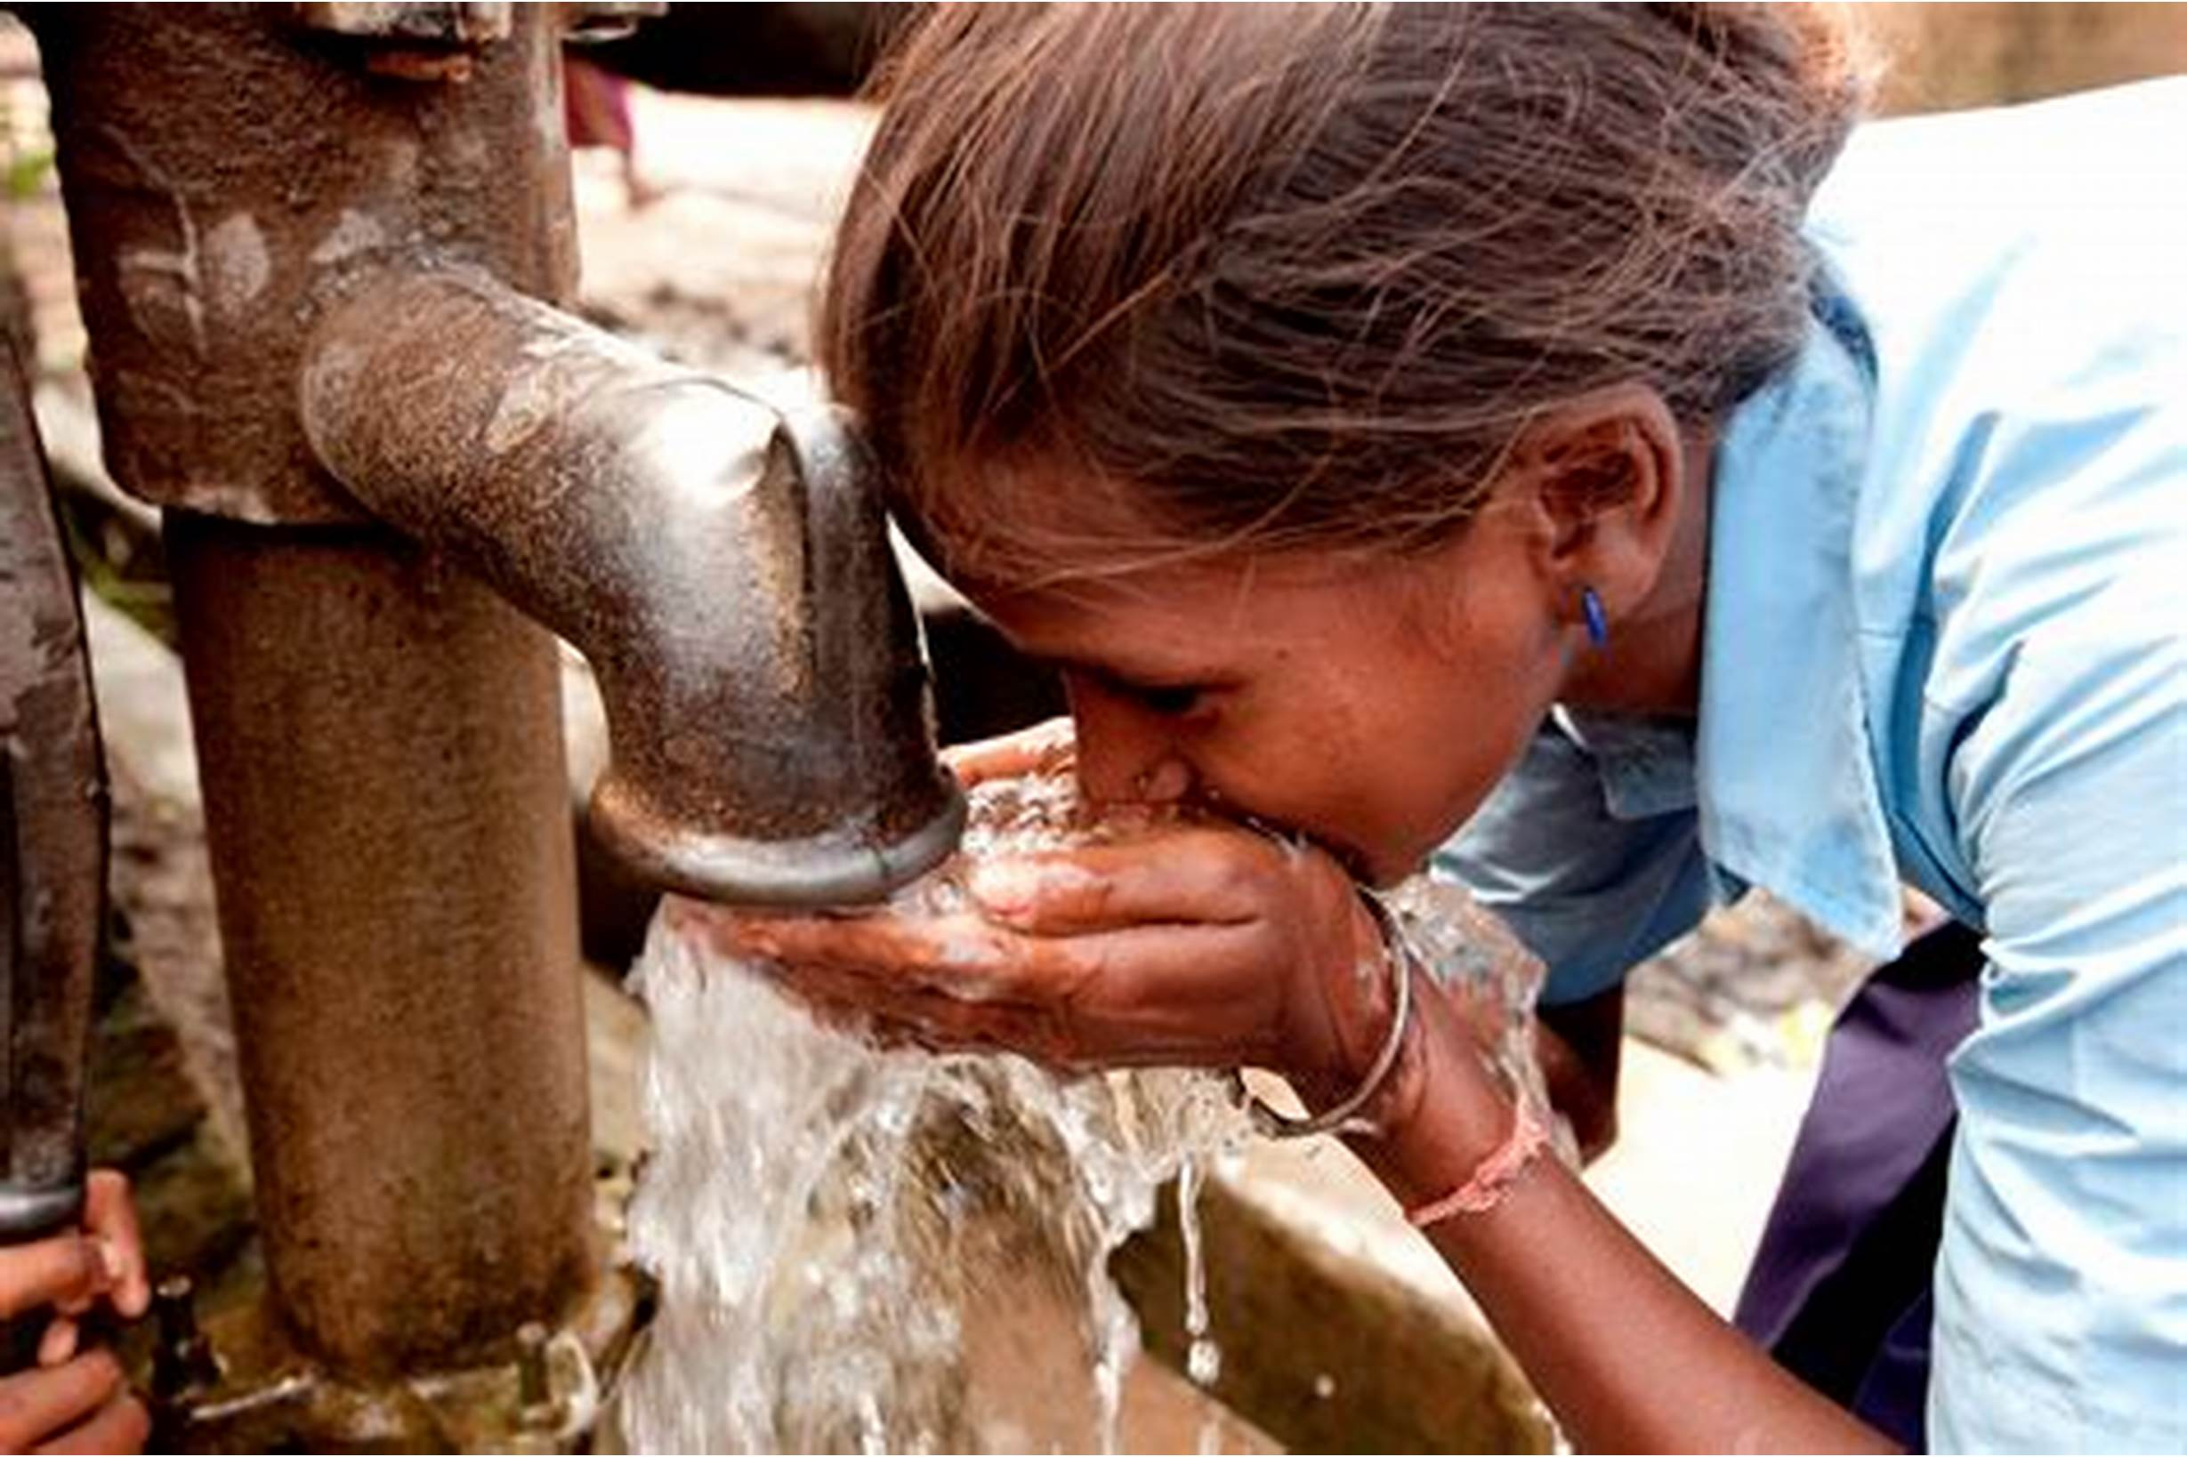
LAND RESOURCES: GROUND WATER
This Photo by Unknown author is licensed under CC BY.

Slide 9
DEPENDENCE ON GROUND WATER :
Groundwater is a vital water supply for humanity.
Groundwater provides drinking water entirely or in part for as much as 50% of the global population and accounts for 43% of all of water used for irrigation.
Worldwide, 2.5 billion people depend solely on groundwater resources to satisfy their basic daily water needs
Although hidden below the Earth’s surface, groundwater makes up 99% of Earth’s liquid fresh water and plays an important role in the water cycle. Rivers, lakes and wetlands are surface manifestations of groundwater, exchanging flow with the groundwater reservoir that feeds them when they need water and takes some of their flow when surface water is present in excess.

Slide 10
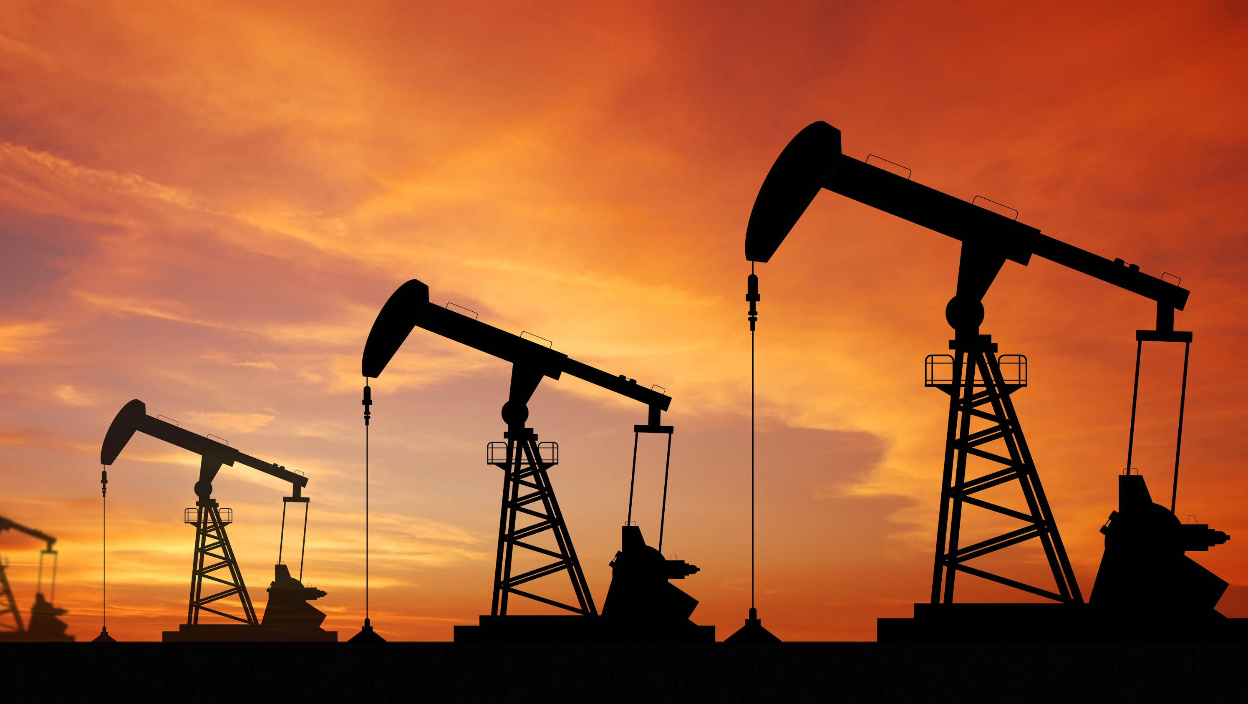

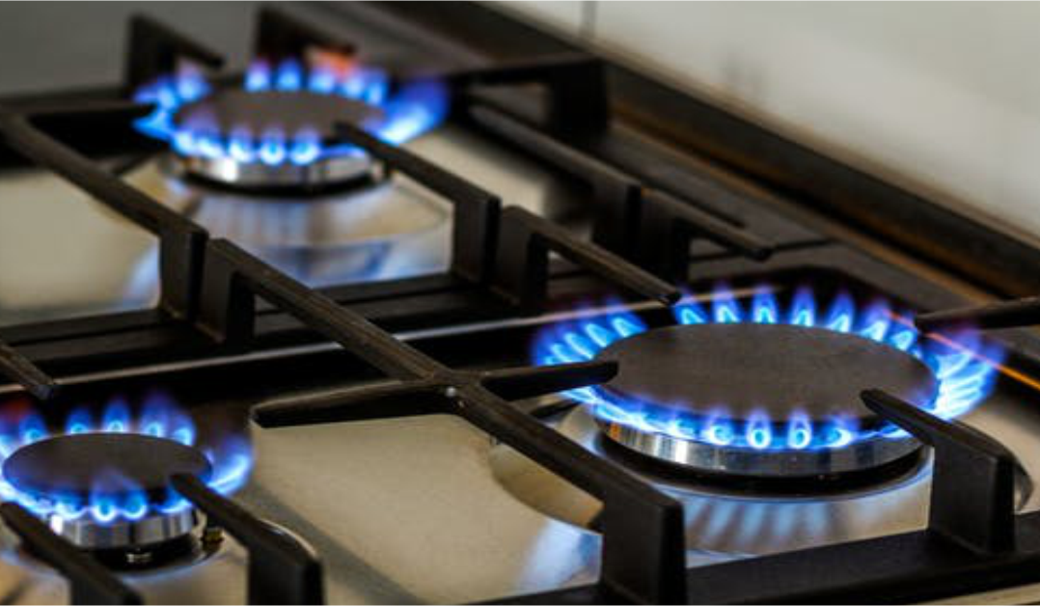
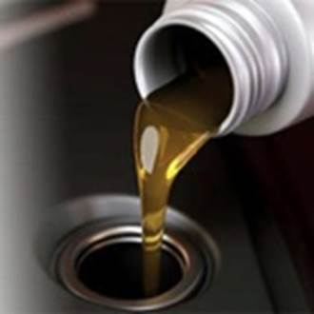
Land resources CRUDE OIL

Slide 11
Crude oil is one of most important resources of land:
Humans are very much dependent on crude oil.
But before the this resource can be sold as a finished product, it needs to undergo refining.
After refining, major products are LPG, gasoline, diesel, jet fuel, fuel oil, and kerosene.
These products are very much important for running of industries and day to day to life of human beings.
It is mainly used as a fuel and combustible, but is also indispensable as a chemical raw material.

Slide 12

Common use of crude oil products are
Fuels like petrol, diesel are used for running vehicles.
LPG is used for cocking food.
It is used for making cloths.
It is used in making of plastics.
It is used in making of gums.

Slide 13
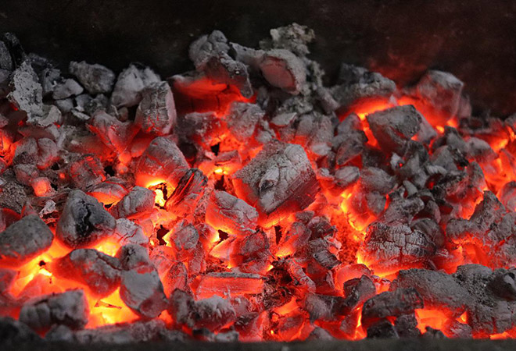
Land resources : fuel like Coal
Coal is a hard rock which can be burned as a fossil fuel.
Coal can be burned for energy or heat.
About two-thirds of the coal mined today is burned in power stations to make electricity.

Slide 14
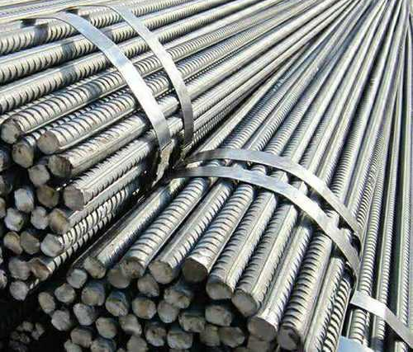
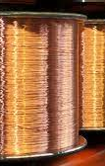
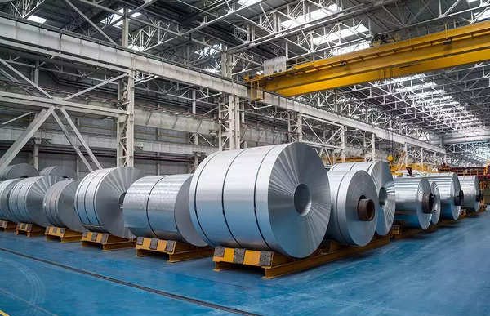
Land resources METALS

Slide 15
Some common metals found in land and their importance's
Iron metal is hard and durable, it is used in concrete structures. Because it can be poured into forms while liquid to produce a great variety of structural elements, it provides an economical substitute for traditional materials, and it has the advantages of continuity (absence of joints) and of fusing with other materials.
Aluminum is a ductile metal and it has a high melting point and good thermal conductivity. Metals like copper and aluminum and alloys like steel are mostly used to make utensils. Due to their ability to conduct heat, copper and aluminum are the most common metals that are used as utensil materials.
Copper is used for electrical wiring because it is a good conductor of electricity. The free electrons in metals can move through the metal, allowing metals to conduct electricity.

Slide 16
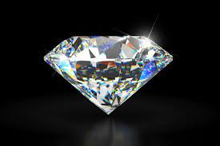
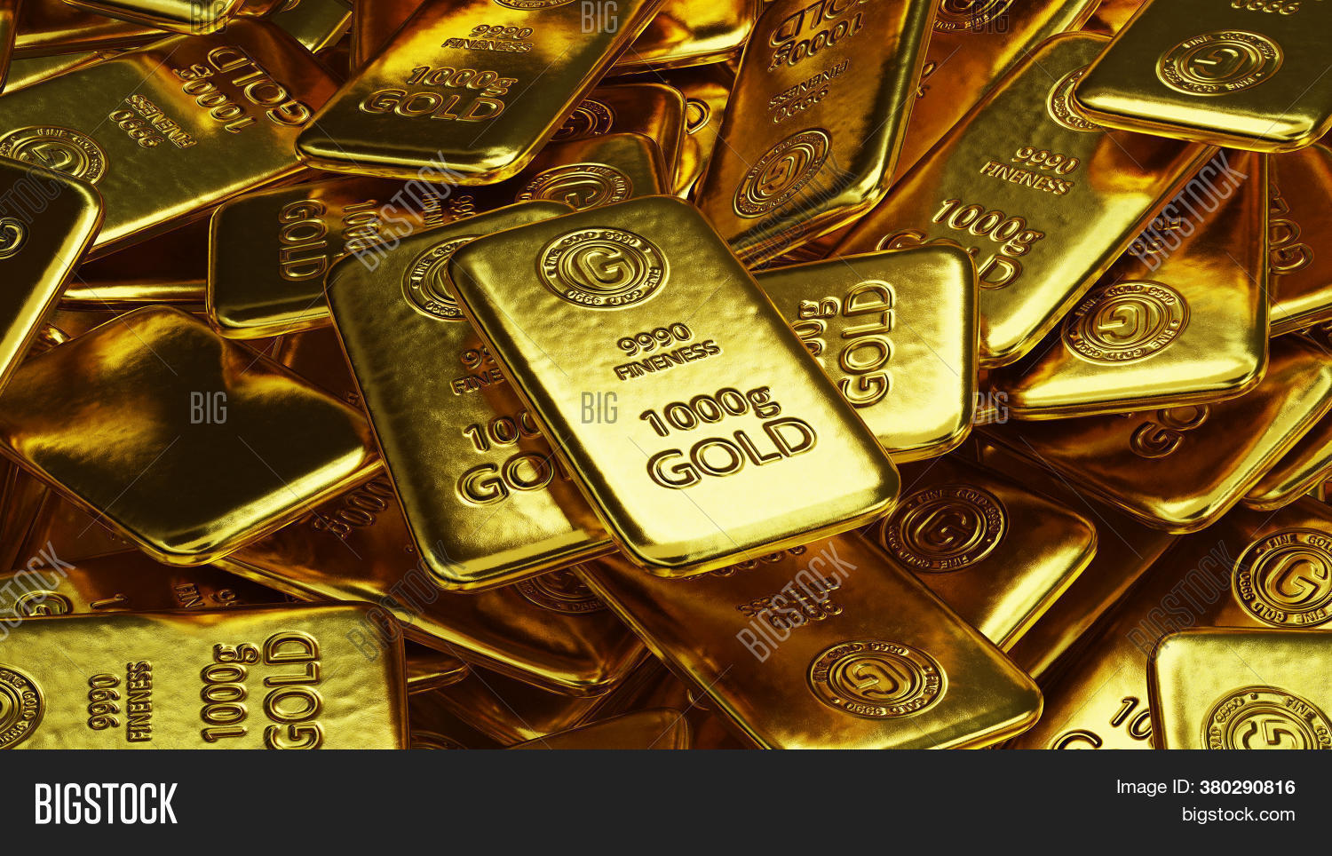
Land resources : Expensive materials like Gold and Diamonds.

Slide 17
Land resources minerals like gold and diamond
Expensive materials like gold and diamond are found in land.
They are commonly used as jewelries but they also used in industries and medical field.
Gold itself also plays a critical role in supporting societies' needs and is considered important across cultures globally. It is deeply understood and recognized as a source of financial security and is critical to numerous technological and healthcare applications.
Diamonds are used for industrial purpose. Its property of hardness is useful to drill, grind or cut materials. Hence, some blades used for cutting and drills in the industry used diamonds.

Slide 18

This Photo by Unknown author is licensed under CC BY-SA.

